Slide 1


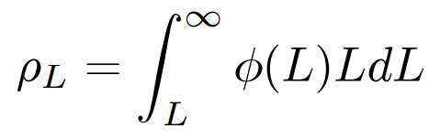

Calculating Higher Limit of Redshift
The z at which reionization begins
Is found from the luminosity density
Is found from an experimental? model

Slide 2
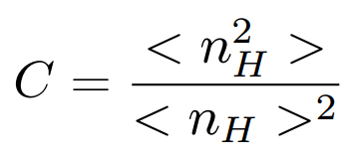
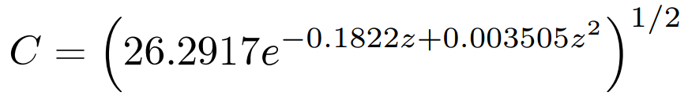
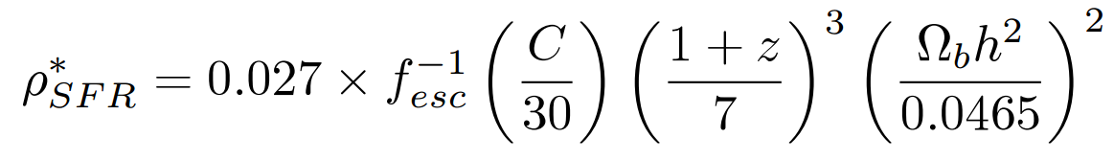
Critical Star Formation Rate Density
Recombination rate is proportional to clumping factor
Clumping Factor
Model
Critical Star Formation Rate Density relation

Slide 3
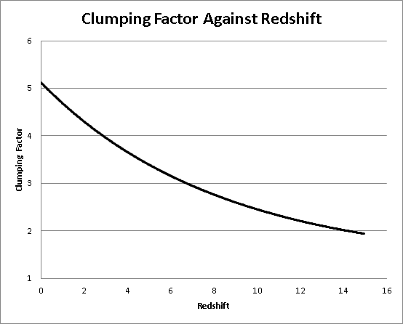

Slide 4
Star Formation Rate Density
Area under the schechter function is infinite unless L is specified
We need a lower luminosity limit
Lower Limit comes from lower mass → Jeans Mass

Slide 5
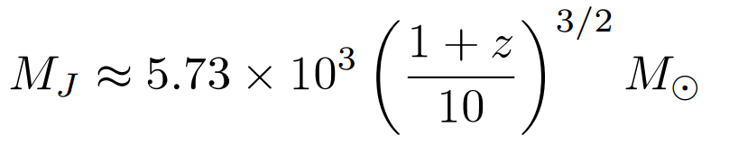
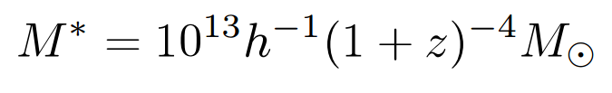
Minimum Luminosity
At z=106, MJ is approximately 1.1x10⁵
Using a Mass-Luminosity ratio of order unity
L=1.1x10⁵ Solar Luminosity
Corresponds to Absolute Magnitude of -7.5

Slide 6
